Slide 1
Primary One Orientation Day 8th July, 2017

Slide 2
St. Clare’s Primary School
Procedure for reading
e-circular for parents
查閱及填寫電子家長通告程序

Slide 3
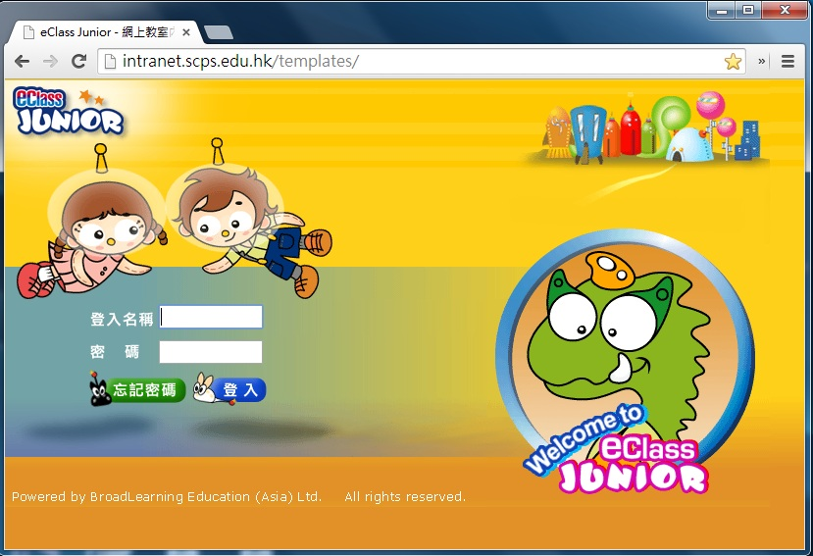
Step 1: Go to our eClass Website at intranet.scps.edu.hk 步驟1: 開啟本校內聯網網頁 intranet.scps.edu.hk

Slide 4
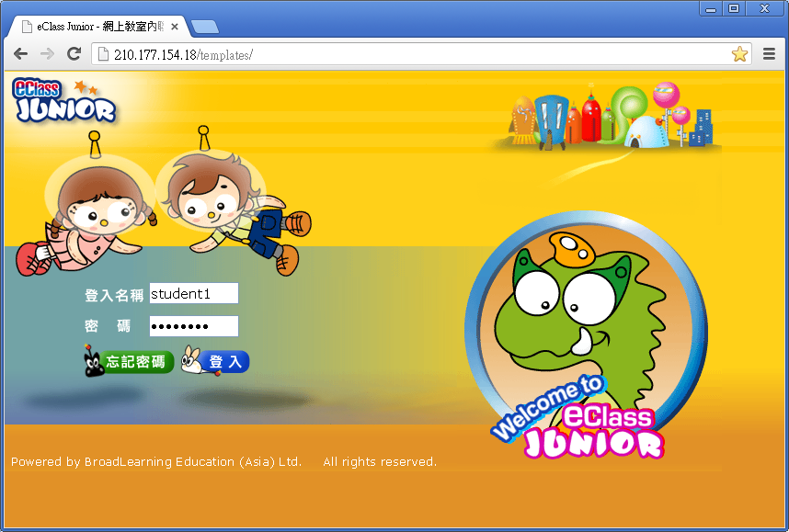
Step 2: Logon with the following login name and password Parent’s Login ID 步驟2: 家長輸入登入名稱及密碼

Slide 5
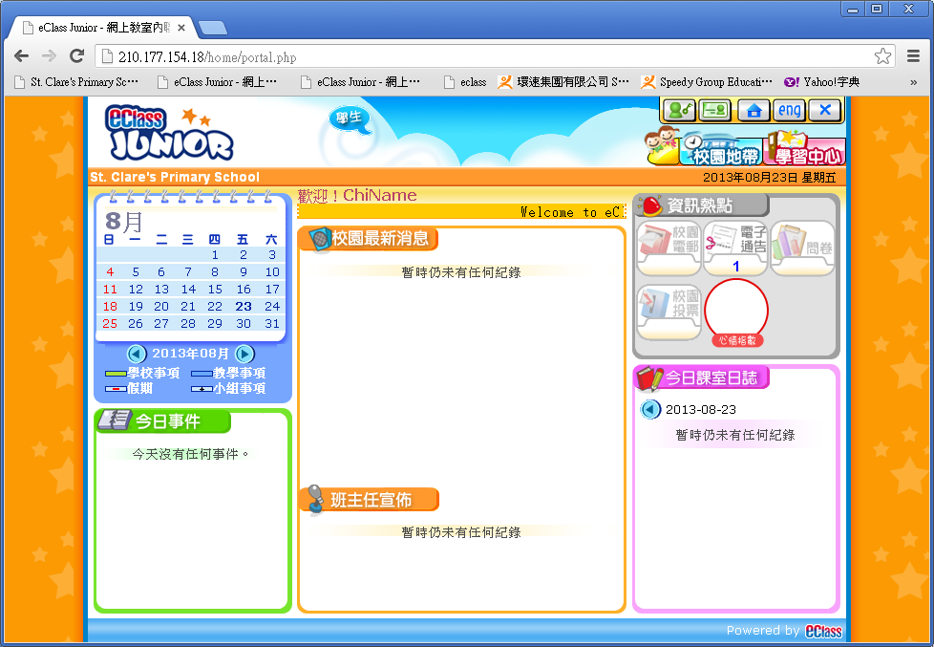
Step 3: After you have successfully logged on, you can find the icon for e-circular on the top right hand corner. Click on the icon, then you can enter the School Circular area. Click the title and open the attached file, then you can read the circular. 步驟 3: 成功登入後，你可見到 電子通告的圖示。點擊該圖示即可進入通告版。點 擊標題及開啟附件即可看到通告內容。

Slide 6
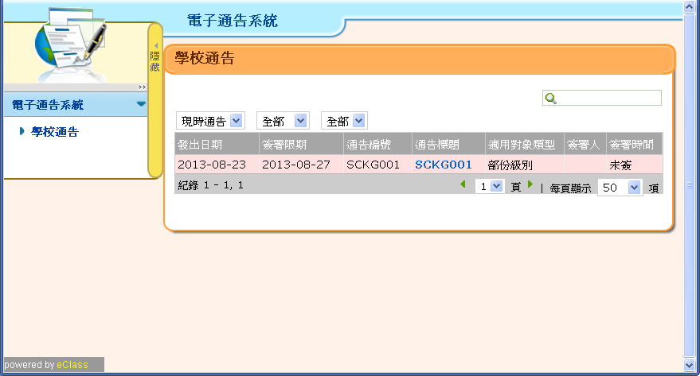

Slide 7
School Environment & Adaptation

Slide 8
New challenges for Primary one students
Social skills
Life skills (self management skills)
Learning attitude
Emotional control
Problem solving skills

Slide 9
Preparing Your Child
Longer school day (7:50 a.m. – 3:10 p.m.)
Your child is expected to extend her attention span in learning
School gate open at 7:20 a.m.
Arrive before 7:45 a.m.
1. Living a Healthy Student Lifestyle
Initiate self-care at school
Hygiene

Slide 10
2. Classroom Rules
A. Politeness
Raise hand before speaking.
Do not leave the classroom during lessons without permission.
Pay attention and show a positive learning attitude.

Slide 11
B. Line Up Rules
Line up appropriately and quietly
A name tag will be given on
1st September, 2017. It shows your child’s position in the line.

Slide 12
3. Organizing & Checking Homework
A. Students:
Follow teachers’ instructions in writing handbook
Present good quality of work
Reinforce a good habit of writing handbook
Place homework assignments in a zipper bag (bigger than A4 size)
Daily homework can be finished after sick leaves

Slide 13
B. Parents:
Check if your child has completed all homework every day
Check e-circulars on school Intranet
Read and sign your child’s handbook, circulars, tests and dictations

Slide 14
4. Before Leaving Home for School:
Record your child’s temperature on student’s handbook and sign every school day
Name all personal items, such as bags, books, shoes and uniform
Check for school bag and stationery
Textbooks and homework
Snack bag and a bottle of water

Slide 15
5. Lunch Policies
Lunch Hour: 12:15 – 1:05 p.m.
Students can order lunch boxes from lunch service provider, or
Bring their lunch, or
Parents can drop off lunch box at the school foyer between 11:45 a.m. to 12:00 n.n.
Students are expected to use cutlery properly and eat on their own. They should tidy up after meals.

Slide 16
Lunch Items
Cutlery (e.g. knife, fork, spoon)
Wet tissue or towel
Lunch mat
Do NOT bring soup or congee

Slide 17
6. General Reminders
A. Appearance
Students must observe all school rules & regulations
Hair must be kept neat. Hair down to shoulder length must be plaited or tied with a rubber band or a ribbon. All hair accessories (e.g. hair clip) should be plain red, black OR dark blue.
All inner garments should be white.
No shiny shoes
May wear white turtle-neck sweaters instead of white shirts when temperature drops to 15 ℃ or below.
May wear dark blue tights, P.E. uniform or dark blue down jacket if temperature is 15 ℃ or below.

Slide 18
B. Attendance
Students must observe the school calendar and attend school accordingly.
A student who is unable to attend lessons because of personal reasons should submit a letter of absence and supporting documents two school days in advance to seek approval from the School.

Slide 19
C. Dismissal
Students should confirm how they dismiss after school (esp. the school bus route no.)
Parents should inform class teachers in written form in advance if there are any changes in daily class dismissal. Parents should also inform the school bus company by themselves.
Parents can make use of the correspondence page on student handbook to communicate with teachers.

Slide 20
D. Immunisation Records
Parents should prepare the immunisation records of the students.

Slide 21
School Curriculum & Timetable

Slide 22
Abbreviations
Eng English | Chi Chinese
LE Longman Express | Maths Mathematics
Gr Grammar | GS General Studies
GW Guided Writing | BK Biblical Knowledge
List Listening | PE Physical Education
Readers Beacon Readers | PTH Putonghua
Compre Comprehension | ECA Extracurricular Activities
WTL Write to Learn | WB Workbook
Dict Dictation | CA Continuous Assessment
IT Information Technology | Tmr Tomorrow
RME Religious & Moral Education | VA Visual Arts

Slide 23
Important dates and time
Date | Time | Remarks
1st – 15th Sept, 2017 (except 8th Sept) | 7:50 am – 1:15 pm | Half day school Have lunch in school Photo shoot on 1st Sept No need to bring textbooks on the first two days
8th Sept, 2017 | (Refer to circular issued in due course) | School Opening Mass at St. Anthony’s Church
Starting 18th Sept, 2017 | 7:50 am – 3:10 pm | Follow school timetable
Bring along story books, school bag, a zipper bag, a pencil case and cutlery
Bring healthy snacks and a bottle of water

Slide 24
Thank You

